Slide 1
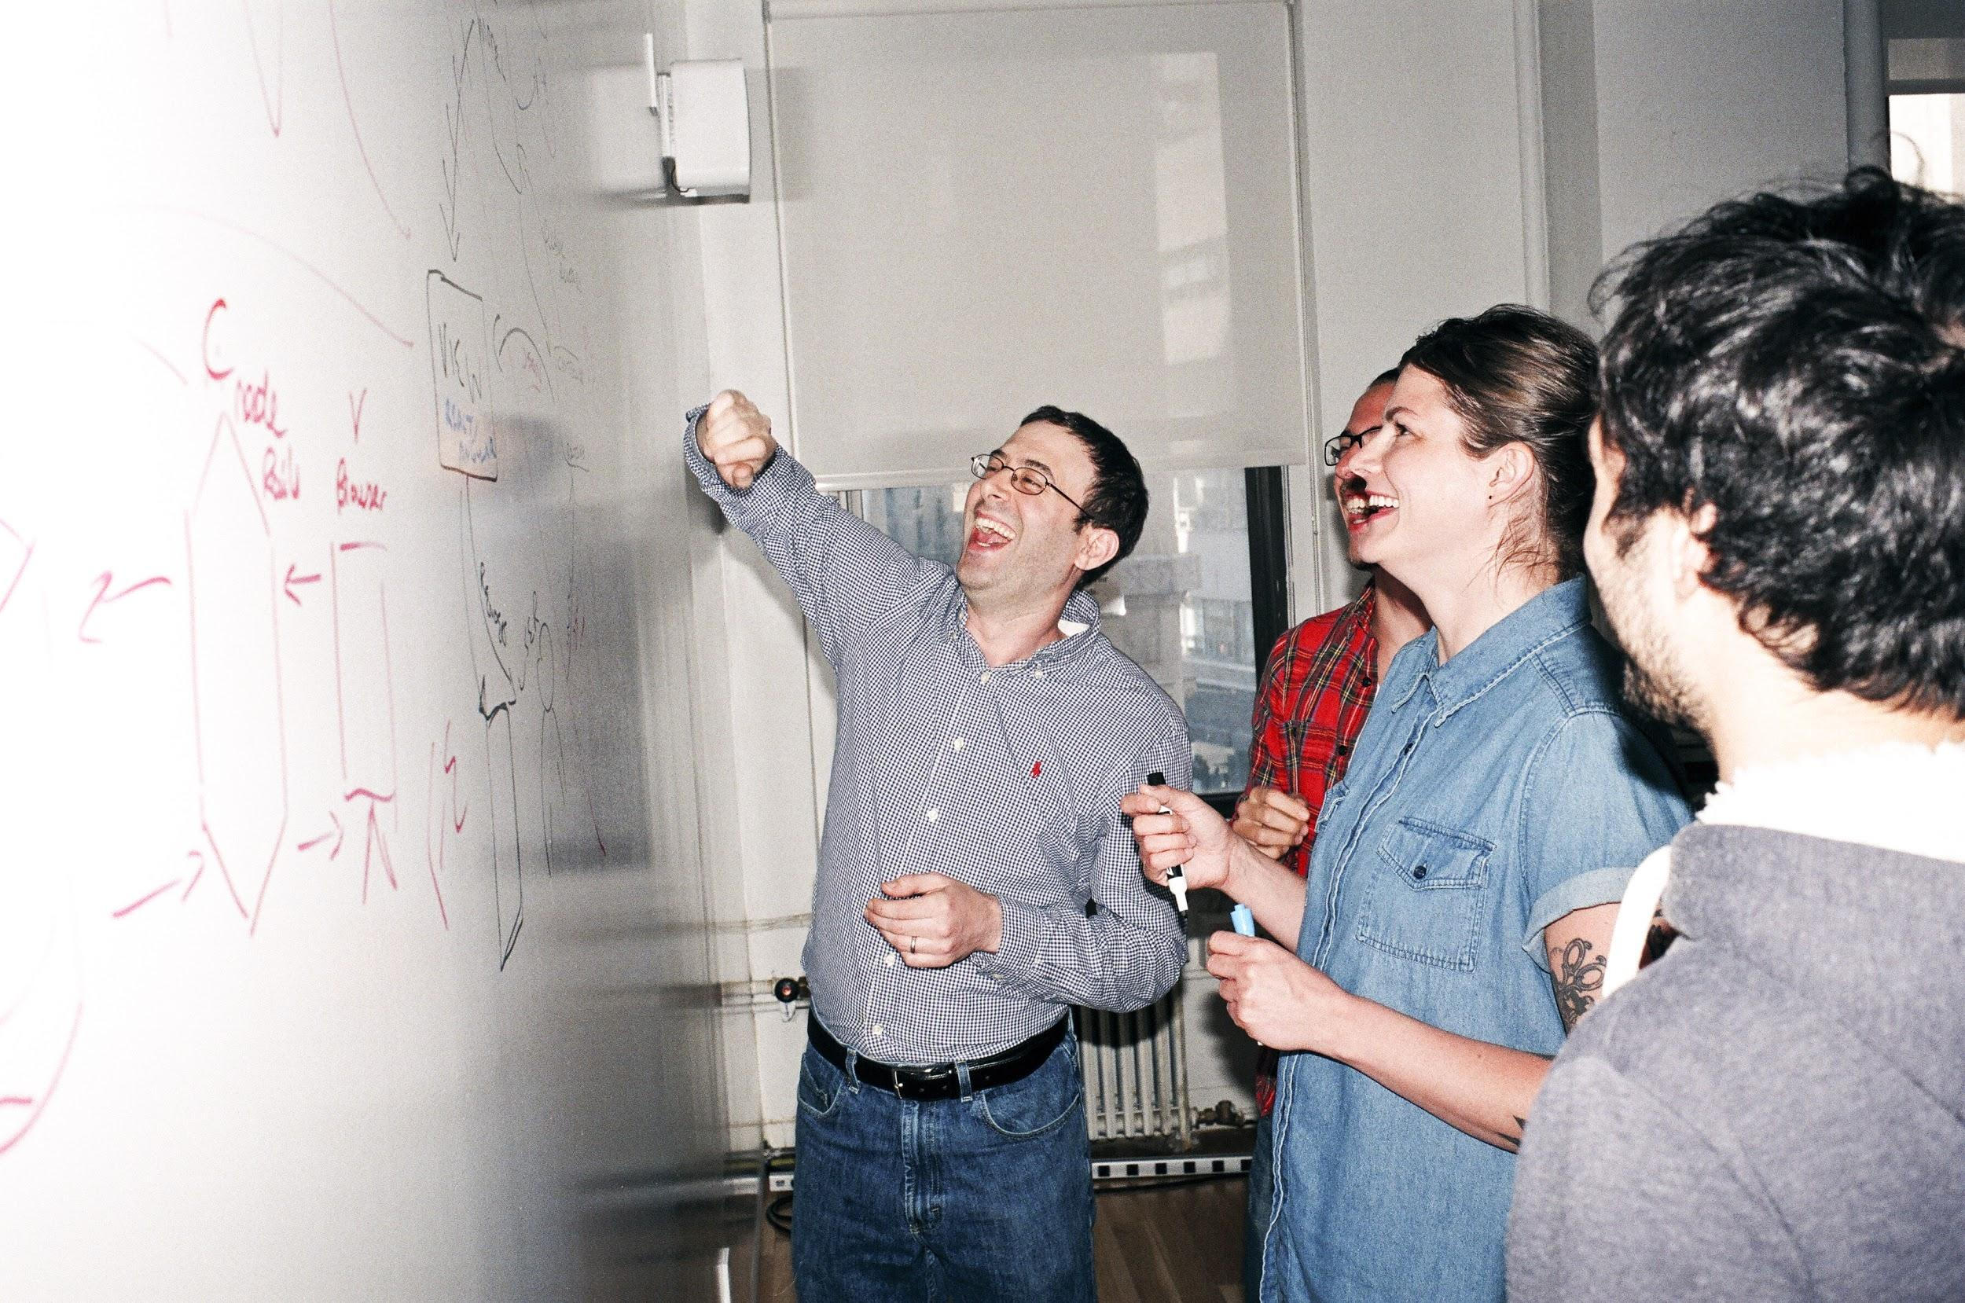

Welcome to General Assembly
WiFi GA Guest
Password yellowpencil
Notes:
[Leave this slide visible until presentation starts]

Slide 2
DATA SCIENCE
10 WEEK PART TIME COURSE
Week 2 Lesson 1 - Data Visualisation

Slide 3
AGENDA & Learning Plan
Key: Interactive Paul Presenting
Course Plan revisited
Recap last time & Homework Presentations
Review – Git & GitHub setup
What is Data Visualisation?
Lab 1
Why do we visualise data?
How do we visualise data?
Different types of Charts
Lab 2
Basic rules for creating a graph
Discussion

Slide 4
Course Plan

Slide 5
Recap – last lesson
Lab1 done? Homework Presentations ~ 2mins each
Lab2 done?
Lab3 done?

Slide 6
Tostee

Slide 7
Jon

Slide 8
Mai

Slide 9
Jesse

Slide 10
John

Slide 11
Student

Slide 12


Review: Git and GitHub

Slide 13
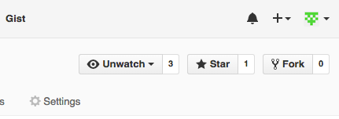
Using Git
Your Copy of the Course Repo
1. Fork
Course Repo
Master
6. Pull Request
2. Clone
5. Push
Your Laptop
Fork - make a copy of someone else’s repository on the git server.
3. Update a file
4. Commit

Slide 14
Using Git
Your Copy of the Course Repo
1. Fork
Course Repo
Master
6. Pull Request
2. Clone
5. Push
Clone copy your (forked repo) to your local machine.
Your Laptop
3. Update a file
4. Commit

Slide 15
Using Git
Your Copy of the Course Repo
1. Fork
Course Repo
Master
6. Pull Request
2. Clone
5. Push
Change make changes to code, add or remove files.
Commit make changes permanent within your cloned repo.
Your Laptop
3. Update files
4. Commit

Slide 16
Using Git
Your Copy of the Course Repo
1. Fork
Course Repo
Master
6. Pull Request
2. Clone
5. Push
Push upload changes to your online repo.
Your Laptop
3. Update files
4. Commit

Slide 17
Using Git
Your Copy of the Course Repo
1. Fork
Course Repo
Master
6. Pull Request
(Not required in this course)
2. Clone
5. Push
Pull Request invite the owner of the master repo to accept your changes.
Your Laptop
3. Update files
4. Commit

Slide 18
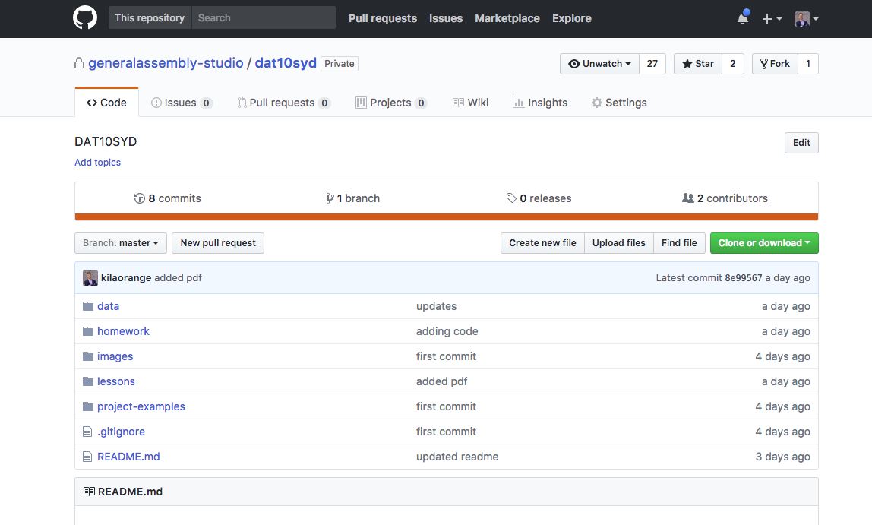
Preparing and Using Your Local Git
Improvement: delete the local Repo we cloned last week
Fork the GA Repo to your own GitHub account https://github.com/generalassembly-studio/dat11syd.git
dat11syd

Slide 19
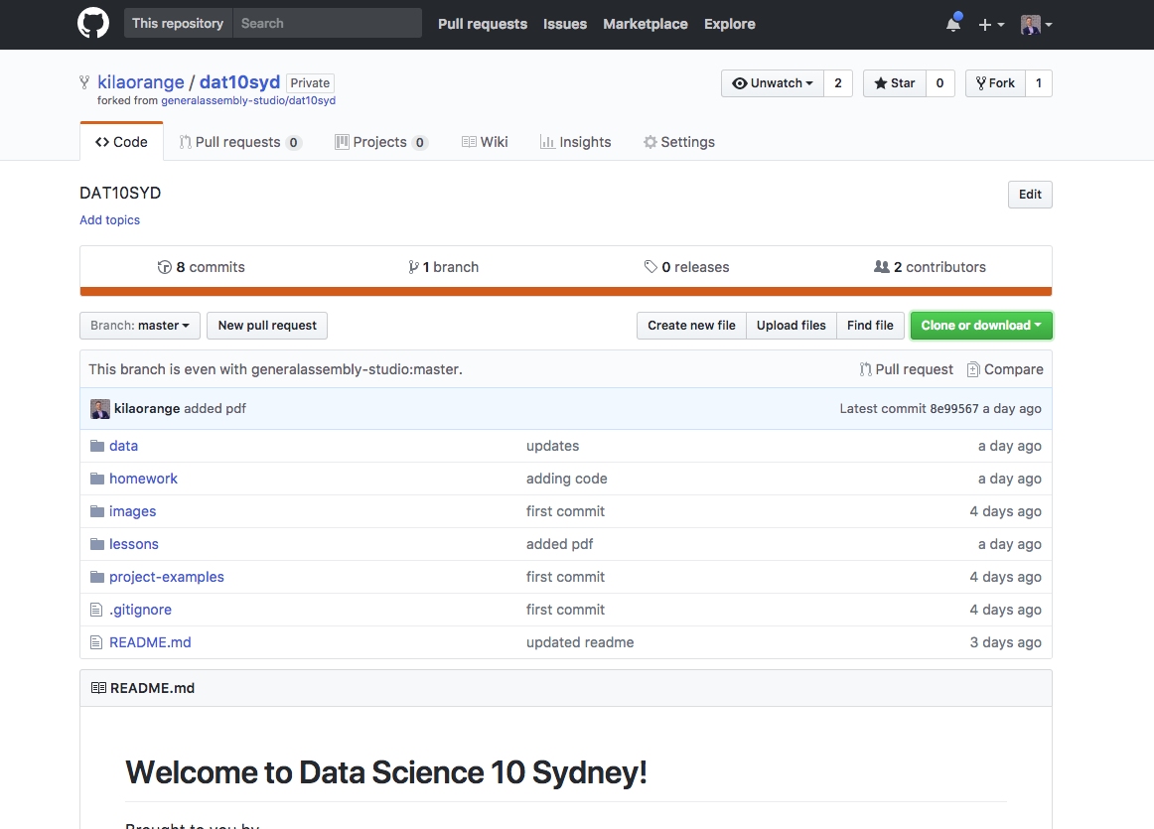
Preparing and Using Your Local Git
It now looks like this…
Copy text

Slide 20
Preparing and Using Your Local Git
Fork the master repo to your GitHub account
Open a terminal (Mac, Linux) or git bash (Windows)
Change working directory to where you want the local repo
$ cd yourpath
Clone
$ git clone https://github.com/yourgithubname/yourgithubrepo

Slide 21
Preparing and Using Your Local Git:
Configure Automatic Updates (Optional)
Configure your local clone to point to the official course repository
$ git remote –v
origin https://github.com/pgoodall1984/dat11syd.git (fetch)
origin https://github.com/pgoodall1984/dat11syd.git (push)
$ git remote add upstream https://github.com/generalassembly-studio/dat11syd
$ git remote -v
origin https://github.com/pgoodall1984/dat11syd.git (fetch)
origin https://github.com/pgoodall1984/dat11syd.git (push)
upstream https://github.com/generalassembly-studio/dat11syd (fetch)
upstream https://github.com/generalassembly-studio/dat11syd (push)

Slide 22
Download new material from official course repo (upstream) and merge it
Ensure you’re in the master branch
$ git checkout master
Grab the latest changes from the master
$ git fetch upstream
Merge the master changes with your repo
$ git merge upstream/master
WARNING: Be careful not to overwrite files you have already changed in your repo unless you want to replace them with the master versions! (Consider renaming yours or doing a PULL REQUEST.)

Slide 23
Commit Changes to Your Local Git and Push to Your Master Repo
Commit
$ git status # show changes
$ git add filename # stages one file
$ git add . # stages all changed files
$ git commit -m your comments # commits file(s), with comments
$ git status # check
Push
$ git push origin master # push request auto accepted
origin = your GitHub repo (forked from course repo) master = course repo

Slide 24
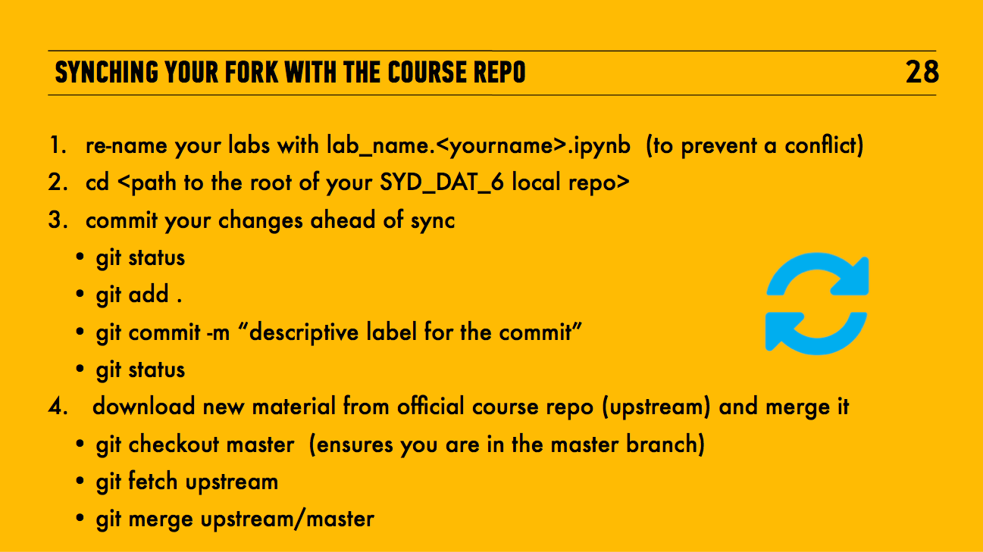
update
Copy your labs from the dat11syd/lessons dir to your dat11syd/students dir
dat11syd

Slide 25
WHAT IS DATA VISUALISATION?
DATA SCIENCE PART TIME COURSE

Slide 26
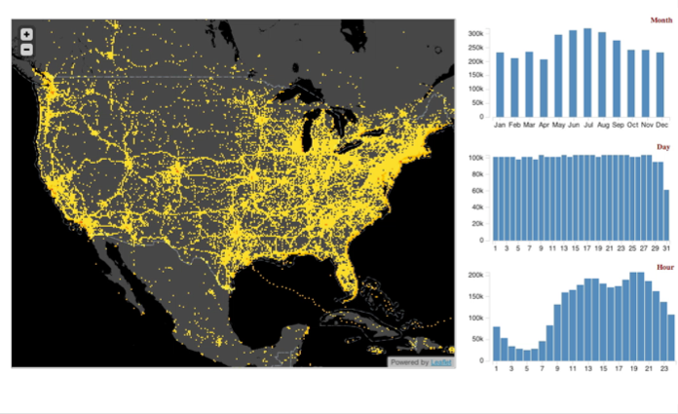
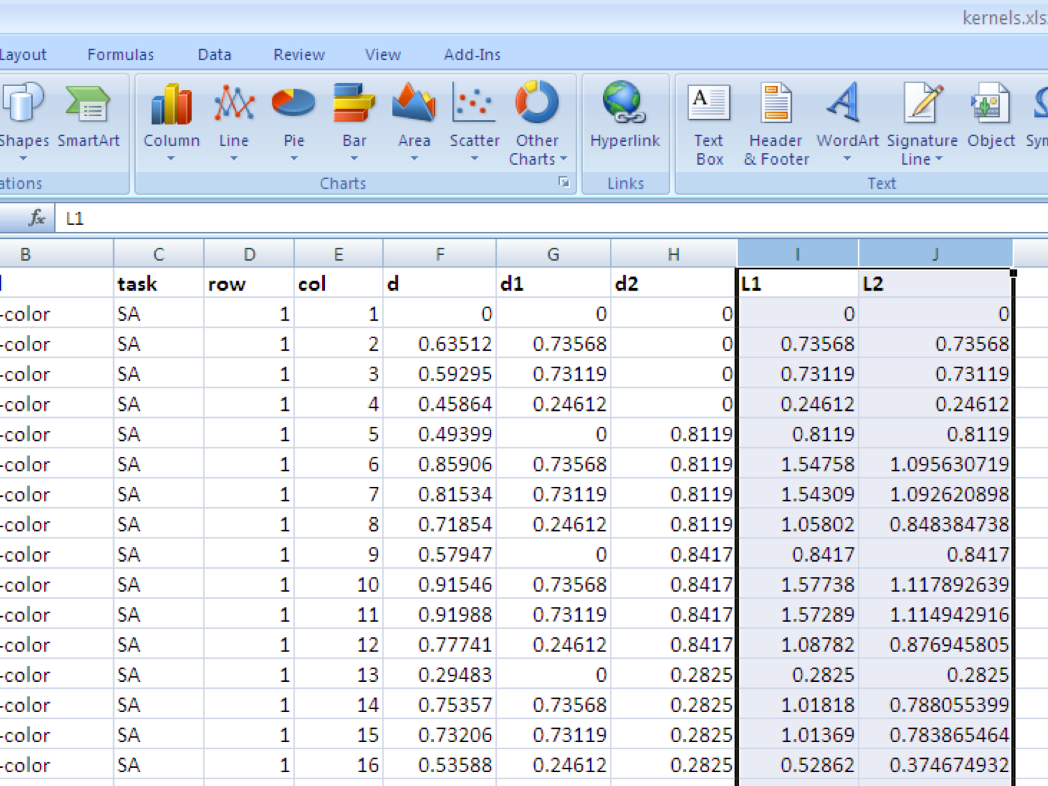
b
Present information that is intuitive and clear for the viewer
Turn numbers in a spreadsheet into something people can interpret and extract insights

Slide 27
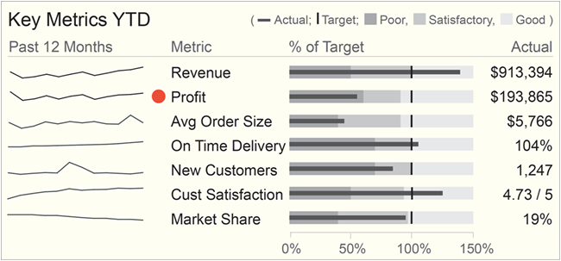
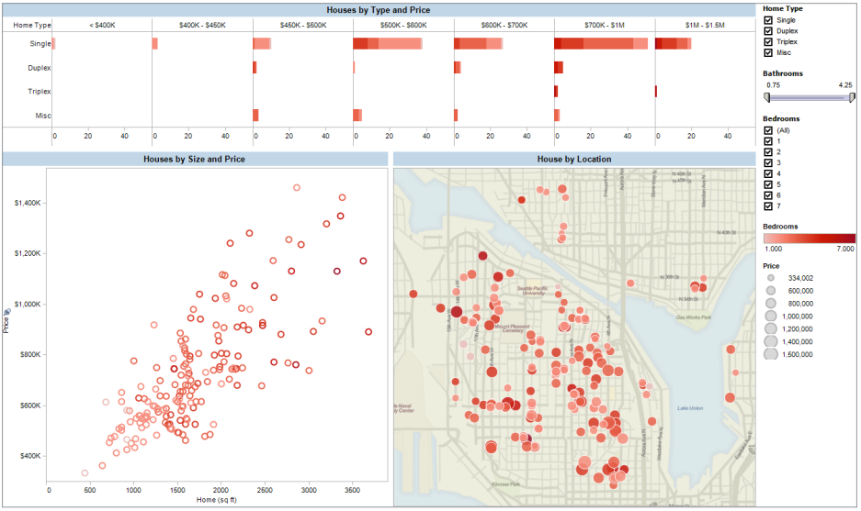
WHY VISUALISE DATA?
Reporting
Dashboards and Business Intelligence
Know the questions you want answers to
Can detect changes from the norm
Good for taking a 30,000 foot view of the problem

Slide 28
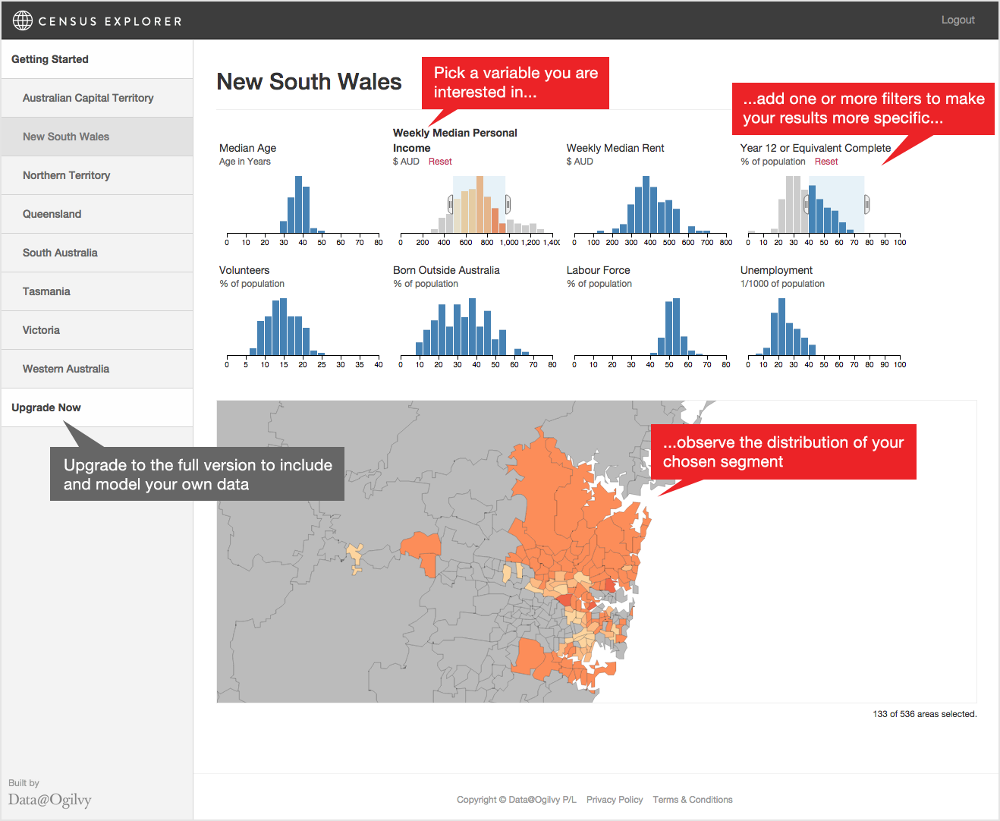
WHY VISUALISE DATA?
Exploring
Exploratory Data Analysis
Combines multiple data sources for single view of a problem
Technical analysis of data
Combined with modelling allows for the discovery of new problems and solutions

Slide 29




HOW DO WE VISUALISE DATA?
Power
Ease of Use

Slide 30
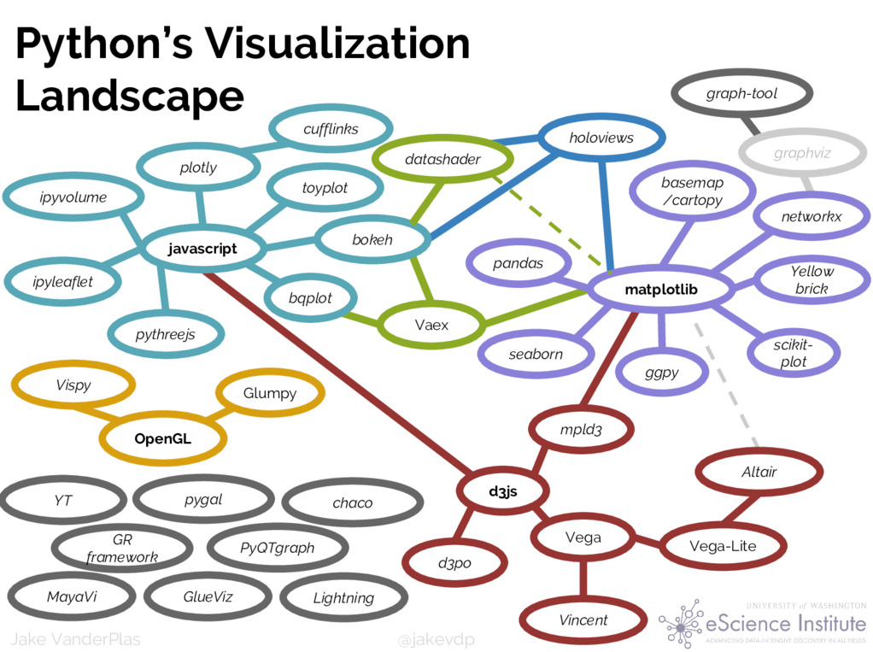
Jake VanderPlas, https://speakerdeck.com/jakevdp/pythons-visualization-landscape-pycon-2017

Slide 31
TOOL TRADEOFFS
Easy to Use | Powerful
Scales to larger datasets
Customised visualisations can create engaging visualisations
Open-source (so free to run and extend)
Non-obvious insights can be discovered with modelling tools
Re-use code to produce similar charts for different data
Provides a useful starting point
Familiar to a large audience
Prototyping and design time is reduced
Default settings reduce the options and thinking that goes into producing a graph
Advantages
Reproducing analysis requires lots of manual effort
Limited to relative small data sets
Solves known problems and cannot answer complex questions
Licensing can be expensive
Requires specialist skills to produce a graph
Training and education for some of the output might be necessary
Disadvantages

Slide 32
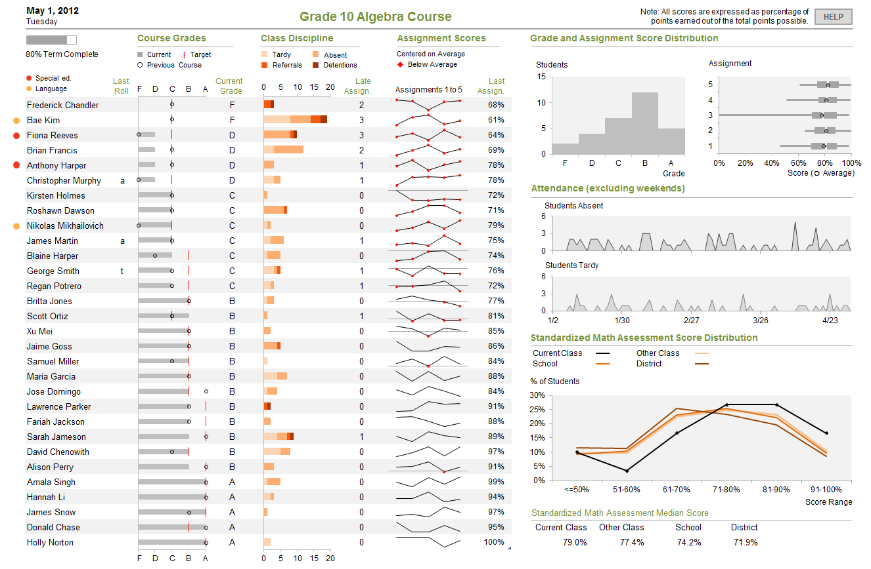
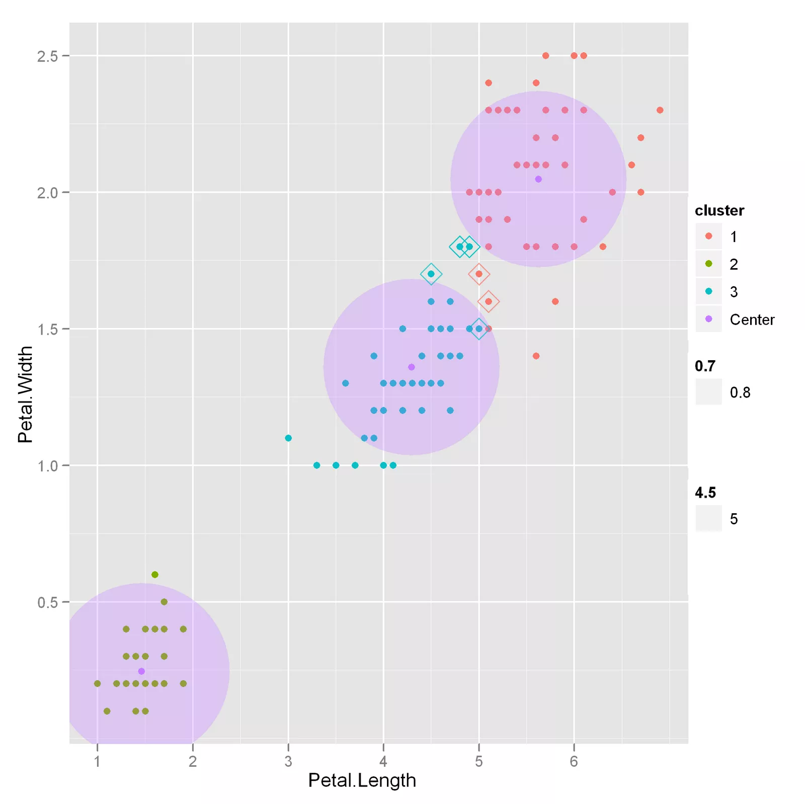
THE VALUE OF DATA VISUALISATION
Communicate what’s happening within the business
Support decisions with information
Measure and report the impact of decisions
Discover ways to improve the business

Slide 33

Enough talking…
Let’s do some lab work:
dat11syd/lessons/lesson-03/lab/lesson-03-lab-01_ReadingData

Slide 34
DIFFERENT TYPES OF CHARTS
DATA SCIENCE PART TIME COURSE

Slide 35
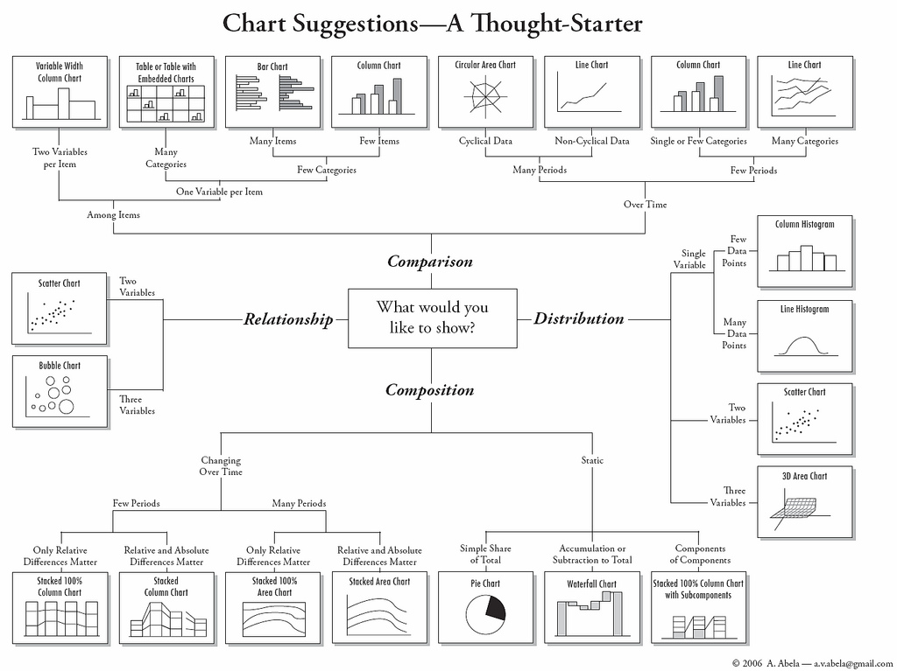

Slide 36
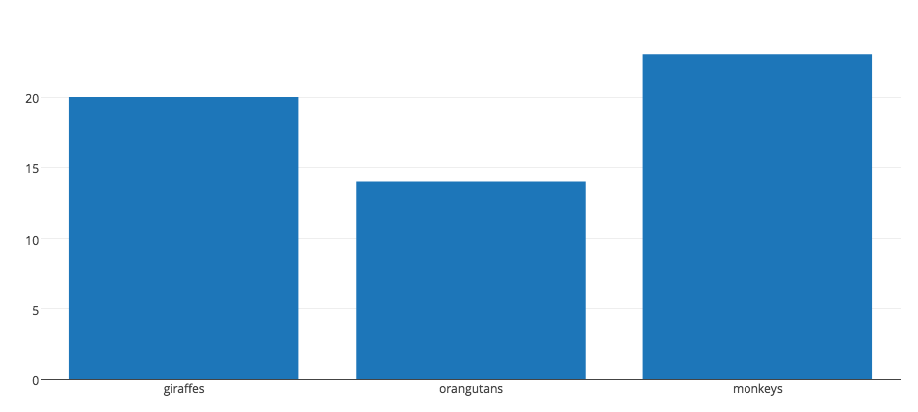
BAR CHART
Shows numeric summaries across different categories (either horizontally or vertically)
Each bar represents a different category in the data
import plotly.plotly as py
import plotly.graph_objs as go
data = [go.Bar(
x=['giraffes', 'orangutans', 'monkeys'],
y=[20, 14, 23]
)]
py.iplot(data, filename='basic-bar')

Slide 37
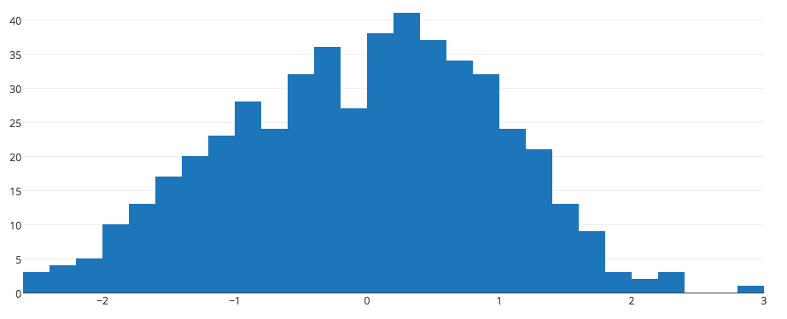
HISTOGRAM
Shows the distribution of data over a continuous interval
Allows us to see the shape of our data
import plotly.plotly as py
import plotly.graph_objs as go
import numpy as np
x = np.random.randn(500)
data = [go.Histogram(x=x)]
py.iplot(data, filename='basic histogram')

Slide 38
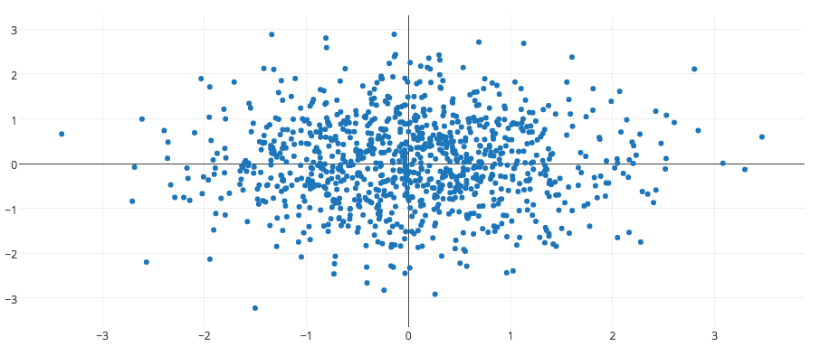
SCATTER PLOT
Shows values between two variables, one on each axis.
Used to see a relationship between variables
import numpy as np
N = 1000
random_x = np.random.randn(N)
random_y = np.random.randn(N)
trace = go.Scatter(
x = random_x,
y = random_y,
mode = 'markers'
)
data = [trace]
py.iplot(data, filename='basic-scatter')

Slide 39
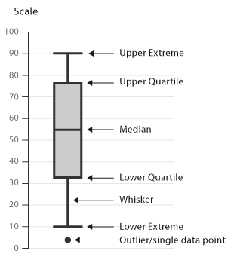
BOX AND WHISKER PLOT
Displays numerical distribution summaries by groups through quartiles
Can compare different distributions
import numpy as np
y0 = np.random.randn(50)-1
y1 = np.random.randn(50)+1
trace0 = go.Box(
y=y0
)
trace1 = go.Box(
y=y1
)
data = [trace0, trace1]
py.iplot(data)
http://www.datavizcatalogue.com/methods/box_plot.html

Slide 40
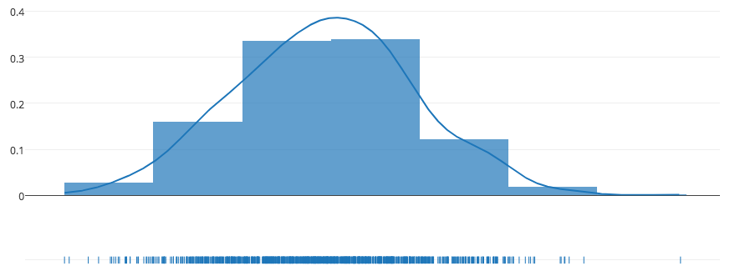
DENSITY PLOT
Similar to a histogram but smooths out the distribution with a continuous line
Not affected by bin choices
import numpy as np
x = np.random.randn(1000)
hist_data = [x]
group_labels = ['distplot']
fig = ff.create_distplot(hist_data, group_labels)
py.iplot(fig, filename='Basic Distplot')

Slide 41
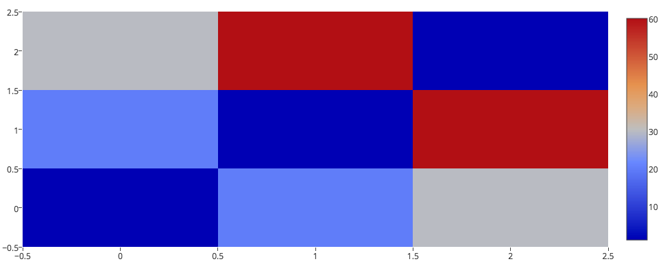
HEATMAP
Colour coding applied to tabular data.
Provides a generalised view of the data by each cell
trace = go.Heatmap(z=[[1, 20, 30],
[20, 1, 60],
[30, 60, 1]])
data=[trace]
py.iplot(data, filename='basic-heatmap')

Slide 42
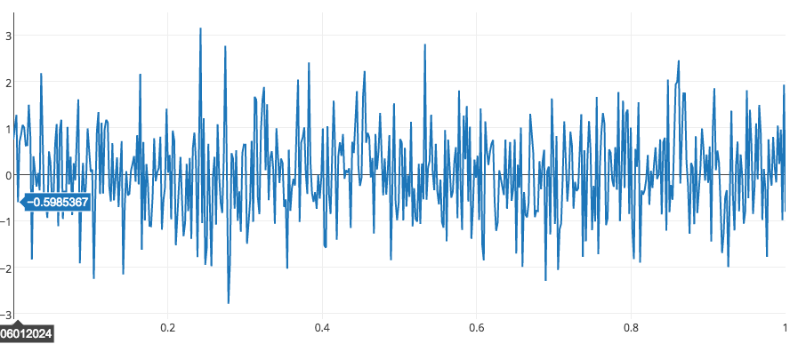
LINE GRAPH
Used to display a numeric value over a continuous value or time
Used to observe trends and changes over time
import numpy as np
N = 500
random_x = np.linspace(0, 1, N)
random_y = np.random.randn(N)
trace = go.Scatter(
x = random_x,
y = random_y
)
data = [trace]
py.iplot(data, filename='basic-line')

Slide 43
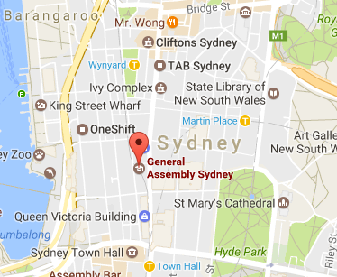
MAPS
Allows us to plot points geographically
We can overlay information on a map, usually loaded as a collection of ‘tiles’.
import folium
map_object = folium.Map(location=[-33.8, 151.2], zoom_start=6, tiles="Stamen toner")
marker = folium.features.Marker([-33.869824, 151.206423], popup=“General Assembly!”)
map_object.add_children(marker)

Slide 44
Enough talking…
Let’s do some lab work:
dat11syd/lessons/lesson-03/lab/lesson-03-lab-02_Visualisation

Slide 45
DIFFERENT TYPES OF CHARTS
DATA SCIENCE PART TIME COURSE
To avoid

Slide 46
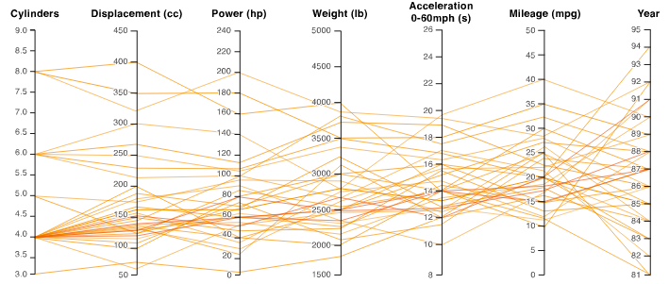
PARALLEL COORDINATES
Plot multiple numeric variables across each observation
Each axis is scaled and each line through the graph is an observation
import plotly.plotly as py
import plotly.graph_objs as go
data = [go.Bar(
x=['giraffes', 'orangutans', 'monkeys'],
y=[20, 14, 23]
)]
py.iplot(data, filename='basic-bar')

Slide 47
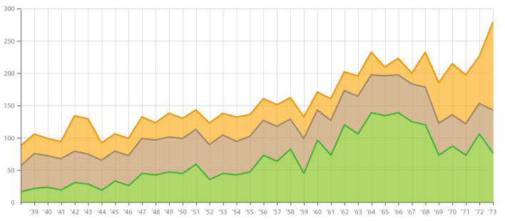
STACKED AREA CHARTS
Try to track changes in a numeric variable across multiple categories
The area under each category is represented by different colours
Better to plot multiple lines rather than stacking the area

Slide 48
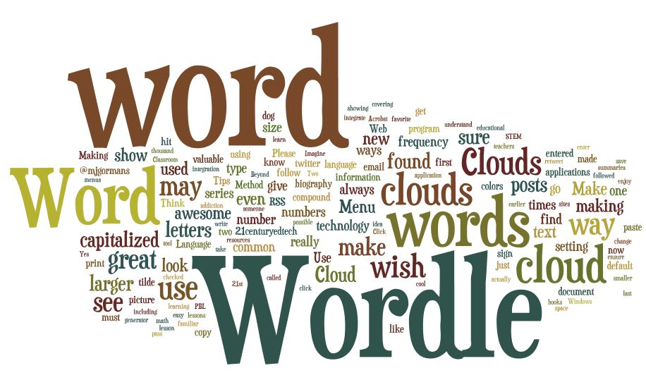
WORD CLOUDS
Collection of words in a text or summary of a corpus
Better to apply some form of categorical detection otherwise similar words will be lots of collection

Slide 49
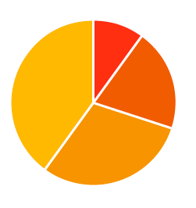
PIE CHARTS
Represent a proportion that a category makes up of the whole
Better to use column charts in most cases

Slide 50
DATA SCIENCE - Week 3 Day 1
DISCUSSION TIME
Review of last week
Further Reading for Data Visualisation
Homework due Friday 24th Nov
Check in with course project
Pre-reading for next lesson

Slide 51
WEEK 1 Review
DISCUSSION TIME
Course Overview
Data Science Overview
Pre-work
Python basics
Git Basics

Slide 52
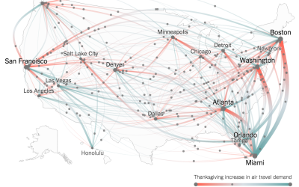
DISCUSSION TIME
Further Reading
Edward Tufte, The Visual Display of Quantitative Information
Leland Wilkinson, The Grammar of Graphics
Scott Murray, Interactive Data Visualisation for the Web (free online)
flowingdata.com
DATA SCIENCE - Further Reading

Slide 53
DISCUSSION TIME
Homework/Course/Project
How’s it going ?
DATA SCIENCE - Week 2 Day 1

Slide 54
PRE-READING
An Introduction to Statistical Learning
Chapter 3 - Linear Regression
DATA SCIENCE - Week 2 Day 1

